Slide 1
IT Accessibility Overview and Strategy
Jeff Kline
Program Director
Texas Statewide EIR Accessibility
jeff kline@dir.texas.gov
1

Slide 2
Accessibility is about all of us
People with Disabilities: Statistics
 | World Wide (2012) | USA(2012) | Texas(2012)
Total Population | 6.8 Billion | 309 Million | 26 Million
Disabled | 1 Billion (15%) | 37 Million (12.1%) | 3 Million (11.5%)
However, disabilities are no longer confined to traditional People with Disabilities
Maturing population
Temporary disabilities
Nonnative language speakers & low literacy
Notes:
Accessibility is about all of Us
To get an idea of the size of the disabled population, consider that there are over six billion people in the world. Approximately one billion of those people have some type of disability.
But accessibility is not confined to what we know as physical disabilities. From our perspective, accessibility means providing access to information technology for all, regardless of age or ability.
Consider the relationship of aging to physical ability. A number of conditions, such as diminished hearing or a lessened ability to see color, are associated with the aging process. Technologies designed to assist people with low vision and hearing impairments can a competitive advantage to organizations with older customers or an aging workforce.
Nonnative speakers with partial fluency can benefit from seeing captions in real time, as a person speaks. Speech-to-text technology can give a competitive advantage to organizations with audiences whose preferred language differs from the spoken language. Serving people who are not native speakers can open new markets or expand existing market share.
Consider also that people with no diminished physical capacity are often in situations where they cannot easily hear or see. “Situational disabilities” are conditions that temporarily restrict a person. As an example, people working on an aircraft carrier cannot hear because of the noise. Similarly, people can have restricted movement from a common condition such as carpal tunnel syndrome. For that matter, when you are driving, you are temporarily visually impaired; you need to keep your eyes on the road, and you can’t easily look at a visual display.
Accessibility is important because it benefits all users. Accessibility is about all of us.

Slide 3
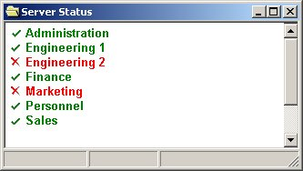
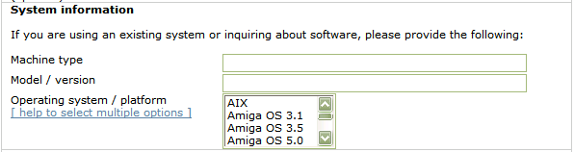
Understanding Disabilities
Blind users access software applications and the Web using a screen reader and the keyboard.
Low vision users need sizable fonts and contrast settings.
Users with limited use of arms and hands need keyboard accessibility features and alternative input methods.
Font size
Larger font size
Even larger
font size
Contrast
Poor
contrast
Contrast
Good
contrast
Alternative input hardware devices
Font size & contrast
“Machine type. Edit.
Model slash version. Edit.
Help to select multiple options. Link.
Operating system slash platform. Listbox. Not selected AIX. 1 of 30.”
Joy Sticks
Keyboards
Deaf users need alternatives for audio content (captioning); the hard of hearing need the ability to increase volume.
Switches
Mouth Sticks
Color-blind users need more than color differences.
Key Types | OS Keyboard Accessibility Features
Mouse Keys | Arrow keys control mouse pointer
Sticky Keys | [Ctrl] then [F] activates [Ctrl-F] shortcut
Slow Keys | Ignore short keystrokes
Repeat Keys | Turn off keystroke repeat Adjust delay before repeat begins Adjust delay between repeats

Slide 4



IT Accessibility Regulations
There are IT accessibility laws and regulations in
Various countries around the world
US federal procurement regulations (Section 508)
Many US states
Most cite accessibility technical standards
Texas statutes and rules
Apply to all Texas state agencies and institutions of higher education
  Texas Government Code 2054 Subchapter M
  Texas Administrative Codes
    1 TAC 206: State Websites
    1 TAC 213: Electronic & Information Resources
  1. US Section 508 is in the final stages of refresh and is adopting WCAG2.0 AA as its new technical standard
  2. DOJ to publish an ANPRM or NPRM on web accessibility for Title II and III entities

Slide 5


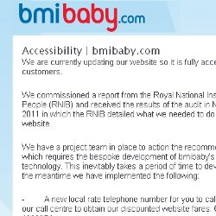















Accessibility-related Complaints / Legal Inquiries on the Rise

Slide 6

Current IT Accessibility Models Not Working Well
Recent US government reports…
Source | Results
National Disability Policy Progress Report - 2012 | Rarely mentions ICT accessibility
Section 508 Report to the President and Congress: Accessibility of Federal Electronic and Information Technology - 2012 | Finds that less than 50% of agency components incorporated specific applicable Section 508 Accessibility Standards as requirements in each procurement solicitation… Little to no validation against Section 508 criteria performed on procured products
US E-Government Website Quality Report - 2012 | The accessibility benchmark shows that two-thirds of federal sites achieved a moderate level of compliance federal sites 28% of sites in the study achieved the lowest compliance band. Automated testing only; tool(s) not defined
The situation in Europe and the rest of the world isn’t any better…
Source | Results
European Commission research behind Proposed Directive on Accessibility of Public Sector websites (Dec 2012) | Only one-third of Europe’s 761,000 public-sector and government websites are accessible
G3ict: CRPD 2012 ICT Accessibility Progress Report | Indicates significant deficits to set in place a foundation to promote ICT accessibility

Slide 7

Reasons for Low EIR Accessibility Adoption
Technical challenges
Continued investments in inaccessible legacy products and platforms
Technology gaps due to omission of accessibility criteria during the creation of new, EIR technology
Organizational Challenges
Lack of awareness of accessibility and its technical standards
Accessibility deemed unnecessary or optional
Accessibility understood too late in project / program to be addressed
Lack of technical skills, tools, or training programs
No organizational policies or objectives related to IT accessibility
No one responsible or accountable for accessibility

Slide 8

IT accessibility today is a governance problem
Pushing technical specifications/standards has not been an adequate adoption driver
Technical standards are execution criteria not governance criteria
Nothing in today’s technical standards address governance
No silver bullet technology solutions on the horizon
Challenge
What can help organizations meet technical standards and government regulations for ICT accessibility?

Slide 9


Public sector governance model trends
President’s Office of Management and Budget (OMB)
“Strategic Plan for Improving Management of Section 508 of the Rehabilitation Act” – Jan. 2013
  Federal agencies must have accessibility statement (policy) on internet / intranet websites
  Template for reporting baseline compliance by agencies to OMB / others
  Naming of a 508 coordinator for each agency
  Delivery of learning modules by the GSA
Ontario: Accessibility for Ontarians with Disabilities Act (AODA)
Requires: Public and private entities with over 20 employees operating in Ontario to
  Establish accessibility policies
  Establish, implement, maintain and document accessibility plans
  File Accessibility Compliance Reports online
  Incorporate accessibility criteria and features into procurement
  Timetables for required compliance
  Fine schedules

Slide 10
Governance included in settlements
HR Block & PeaPod
Appoint a skilled web accessibility coordinator who will report directly to an executive
Adopt a web accessibility policy
Mandatory accessibility training for web content personnel
Youngstown State University & University of Montana
Develop web accessibility policy and an implementation and remediation plan
Mandatory accessibility training for web content personnel
Put in place mechanisms to ensure that the sites continue to be accessible.
Notes:
Note also settlements in higher ed and other government entities.

Slide 11
Policy Driven Adoption for Accessibility (PDAA)
The integration of IT accessibility governance into organization policies in a way that enables them to drive themselves to improve accessibility adoption.
    Makes IT accessibility difficult to ignore
    Not prescriptive, tells what, not how
    Governed through non-technical methods
    Accelerates marketplace innovations

Slide 12
How does PDAA implementation help vendors?
Organizations with fully implemented PDAA can have:
Competitive advantage in public sector solicitations
Improved Search Engine Optimization (SEO)
Increased market share through expansion of customer base
Increased brand equity through social responsibility
Improved ability to hire and retain people with disabilities
Risk mitigation if ADA complaints / litigation arises
  In ICT accessibility, E for Effort counts!

Slide 13

PDAA Ad Hoc Workgroup
  Established with NASCIO member representation from 9 states and 1 federal government agency
  Develop a common set of PDAA criteria for consideration in participant organization procurement processes
  Will include supporting deliverables for vendor self guidance and progress measurement
  Use as a model for adoption beyond the participant organizations if successful
  Deliverables created by multistate subgroup pf accessibility SMEs
    Sarah Bourne: Director of IT Accessibility, MassIT, Commonwealth of Massachusetts
    Jeff Kline: Program Director, Statewide EIR Accessibility, Texas Department of Information Resources
    Jay Wyant: Chief Information Accessibility Officer, Minnesota IT Services

Slide 14
PDAA Deliverables
Deliverables completed and reviewed by workgroup members:
PDAA Core Criteria
PDAA Maturity Model
Self-assessment form/questionnaire for vendors
PDAA FAQs
Generic vendor implementation timeline
List of resources

Slide 15
PDAA Core Criteria for Vendors
Develop, implement, and maintain an ICT accessibility policy.
Establish and maintain an organizational structure that enables and facilitates progress in ICT accessibility.
Integrate ICT accessibility criteria into key phases of development, procurement, acquisitions, and other relevant business processes.
Provide a process for addressing inaccessible ICT.
Ensure the availability of relevant ICT accessibility skills and other resources within (or to) the organization.
Make information regarding ICT accessibility policy, plans, and progress available to customers.

Slide 16
PDAA Core Criteria #1
 | Core Criteria | Launch | Integrate | Optimize
1. | Develop, implement, and maintain an ICT accessibility policy. | Have an ICT accessibility policy. | Have appropriate plans in place to implement and maintain the policy. | Establish metrics and track progress towards achieving compliance to the policy.
Develop, implement, and maintain an ICT accessibility policy.
Creates a foundation on which accessibility programs and initiatives can be built.
Ensures continuity of accessibility efforts by supporting strategic rather than tactical efforts.
Allows people in different roles across the organization to understand their responsibilities.

Slide 17
Policy Exercise
Basic questions organizations need to answer in an IT accessibility policy | Responses
Why do we need it?
What do we need to do?
Who is responsible?
Where does it apply?
When should it take effect?
How do we execute?

Slide 18
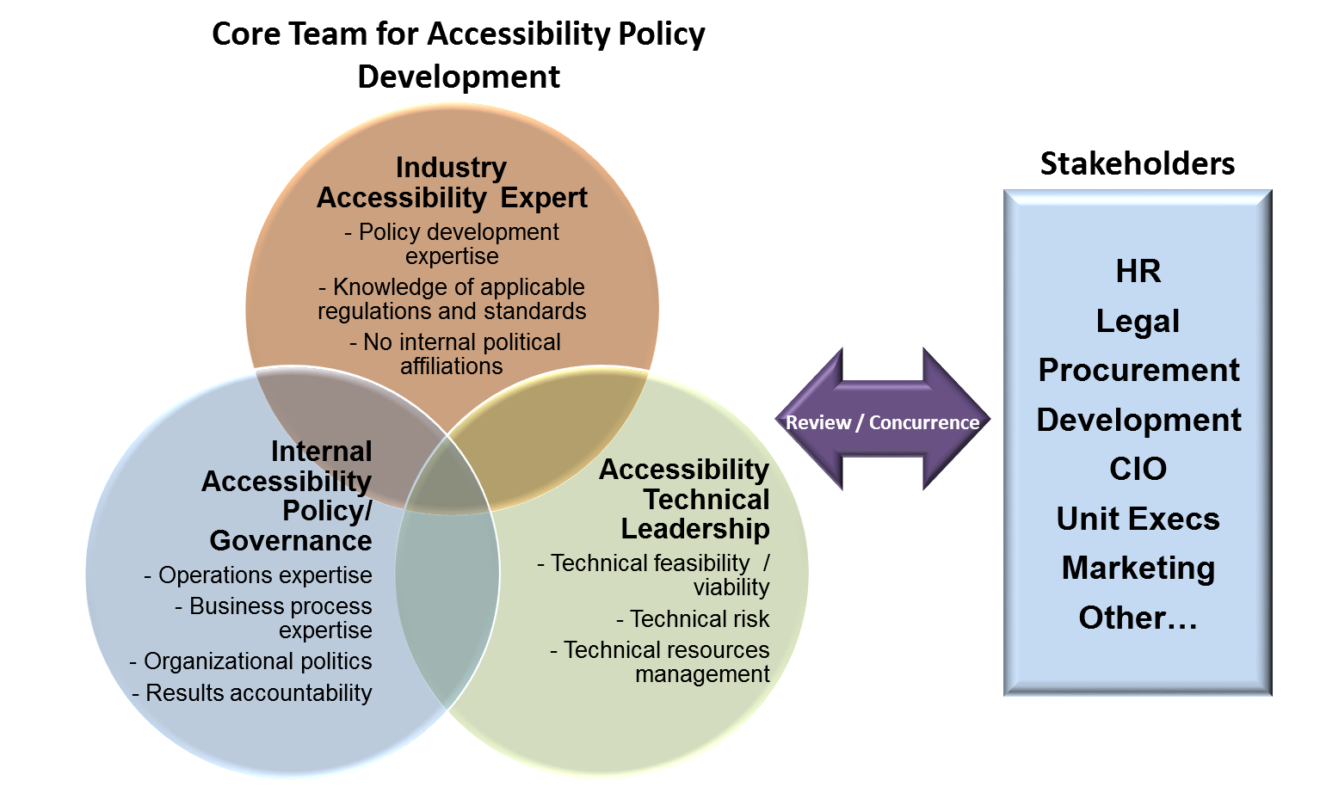
Developing an organization-wide
IT accessibility policy

Slide 19
PDAA Core Criteria #2
 | Core Criteria | Launch | Integrate | Optimize
2. | Establish and maintain an organizational structure that enables and facilitates progress in ICT accessibility. | Develop an organization wide governance system. | Designate of one or more individuals responsible for implementation. | Implement reporting/decision mechanism and maintain records.
Establish and maintain an organizational structure that enables and facilitates progress in ICT accessibility.
Ensures that ICT accessibility roles are identified and positioned within the organization for greatest impact
Defines responsibilities across the organization, including the designation of an executive sponsor.

Slide 20
“Neutral Placement” Organization Exercise
Organization Area | Pros | Cons

Slide 21
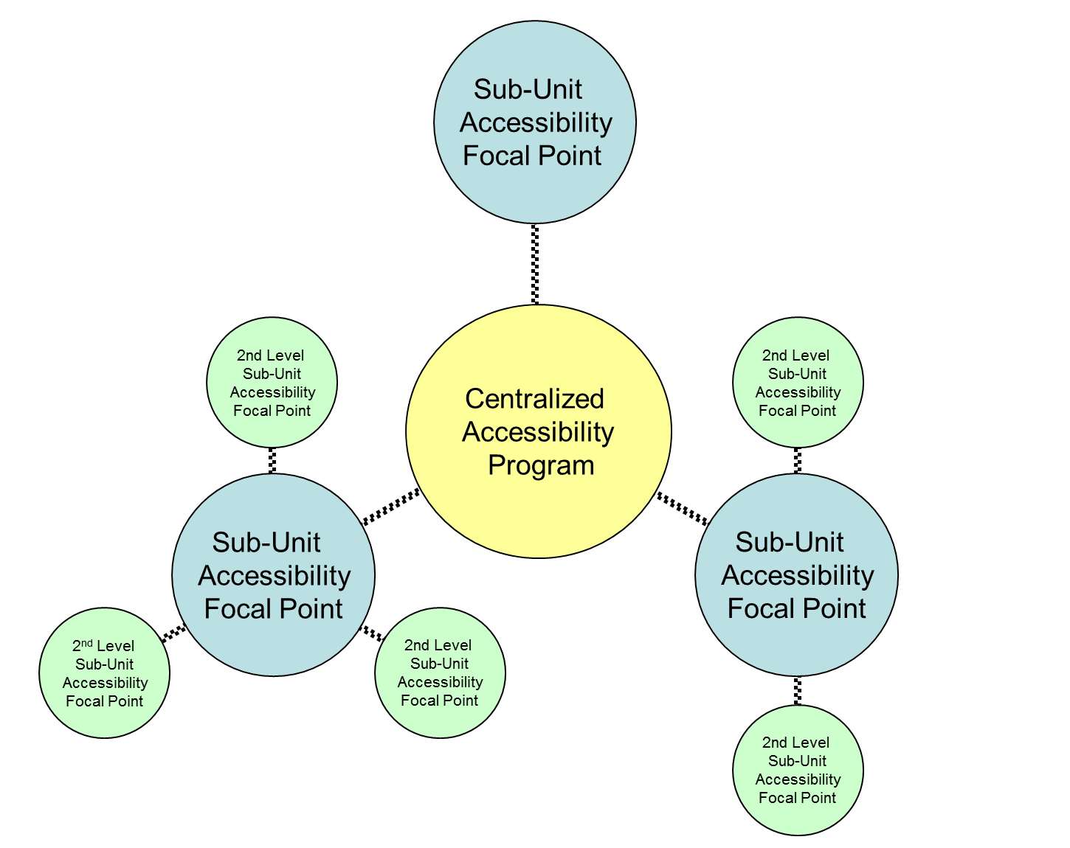
Organizing accessibility
Senior manager “executive sponsor”
“Neutral” organizational placement
  Analysis of implications based reporting organization
Centralized accessibility function
  Policy and governance
  Technical consulting
  Business development / sales support
  Project office
  Other?
Sub-Unit focal points / coordinators

Slide 22
Roles and responsibilities of accessibility coordinator(s) / focal point(s)
Guiding and Consulting | Provides leadership and guidance, and acts as liaison to all functional areas where IT is developed or procured. Recommends and advises on IT accessibility criteria for integration into business process.
Ensuring Compliance | Develops and maintains policies, procedures, guidelines ,and tools that help meet the Texas statutory and rule requirements in IT accessibility. Consults with operations and IT procurement staff members to ensure that accessibility requirements are incorporated into IT procurement processes (SOWs, specifications, receiving, etc.)
Planning | Develops IT accessibility strategies and implementation plans. Plans, monitors, and coordinates IT accessibility activities.
Reporting | Reports IT accessibility status, progress, and other relevant information to management.
Training and Promoting | Champions and builds support for IT accessibility among staff members Identifies IT accessibility training needs and develops training plans to meet those needs.
22

Slide 23
PDAA Core Criteria #3
 | Core Criteria | Launch | Integrate | Optimize
3. | Integrate ICT accessibility criteria into key phases of development, procurement, acquisitions, and other relevant business processes. | Identify candidate processes for criteria integration. | Implement process changes. | Integrate fully into all key processes.
Integrate ICT accessibility criteria into key phases of development, procurement, acquisitions, and other relevant business processes.
Ensures that ICT accessibility is implemented in a consistent, repeatable fashion
Removes dependency on specific individuals who “carry the torch” for specific events or projects where ICT accessibility is required.

Slide 24
Process Integration Exercise
Identified Business Process where Accessibility Plays a Role
Product Development
Procurement

Slide 25
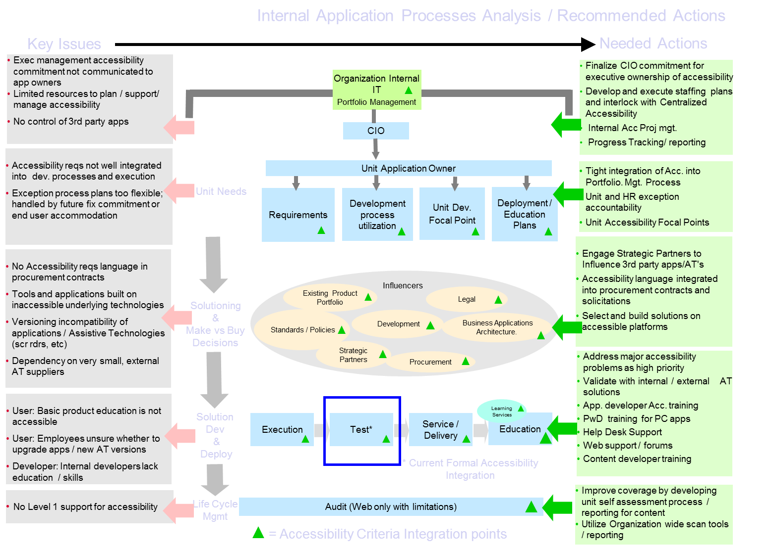
Integrate Accessibility into Key Business Processes: Analysis Example

Slide 26
PDAA Core Criteria #4
Provide a process for addressing inaccessible ICT.
Ensures that plans are developed to address ICT accessibility issues once identified.
Provides a mechanism to implement accommodations until the ICT is accessible
 | Core Criteria | Launch | Integrate | Optimize
4. | Provide processes for addressing inaccessible ICT. | Create plans that include dates for compliance of inaccessible ICT. | Provide alternate means of access until the ICT is accessible; implement corrective actions process for handling accessibility technical issues and defects | Maintain records of identified inaccessible ICT, corrective action, and tracking.

Slide 27
Addressing Inaccessible ICT Exercise
Methods to Address Inaccessible ICT

Slide 28
PDAA Core Criteria #4: Examples
  Examples of addressing inaccessible ICT
  Corrective actions identification and tracking in product development life cycle
  Procurement of future, more accessible ICT
  Mechanism for providing alternate means of access until the ICT is made accessible or replaced
    1-800 numbers, etc.

Slide 29
PDAA Core Criteria #5
Ensure the availability of relevant ICT accessibility skills and other resources within (or to) the organization.
Identify necessary knowledge/skills and existing gaps
Provide training opportunities
Include accessibility skills in hiring criteria
Track and manage gaps
 | Core Criteria | Launch | Integrate | Optimize
5. | Ensure the availability of relevant ICT accessibility skills within (or to) the organization. | Define skills/job descriptions. | Identify existing resources that match up and address gaps. | Manage progress in acquiring skills and allocating qualified resources.

Slide 30
Identify Skill Gaps and Build “Role Based” Accessibility Training Plans
Course Level | Course Title | All Staff | Web Content Producers | Web & Application Testers | Web Application Developers | Procurement Staff | Contract Writers | Contract Compliance | Project Managers
Fundamentals | Introduction to Accessibility (Self) | Required | Required | Required | Required | Required | Required | Required | Required
Fundamentals | Office Documents (Internal) | Optional | Required | Optional | Optional | Required | Required | Optional | Required
Fundamentals | PDF (Internal) | Required / Optional* | Required | Optional | Optional | Required / Optional* | Required / Optional* | Required / Optional* | Required / Optional*
Fundamentals | HTML (Internal or External) |  | Required | Required | Required
Fundamentals | HTML Forms (Internal or External) |  | Required | Optional | Required
Fundamentals | Testing & Tools (Internal or External) |  | Required | Required | Required
Fundamentals | CSS (Internal or External) |  | Optional | Optional | Required
Fundamentals | Javascript (Internal or External) |  | Optional | Optional | Required
Advanced | Sharepoint / Dreamweaver (Internal or External) |  |  |  | Required / Optional*
Advanced | ASP / ASP.Net (Internal or External) |  |  |  | Required / Optional*
Advanced | Java / JSP (Internal or External) |  |  |  | Required / Optional*
Advanced | Web 2.0 Technologies (Internal or External) |  |  |  | Required / Optional*
Specialized | Accessibility Law, and its Impacts |  |  |  |  | Required | Required | Required | Required
Specialized | Accessibility in Contract Solicitations |  |  |  |  | Required | Required | Required | Required
Specialized | Understanding/validating Vendor IT accessibility |  |  |  |  | Required | Required | Required | Required
* As needed based on assignment.

Slide 31
PDAA Core Criteria #6
 | Core Criteria | Launch | Integrate | Optimize
6. | Make information regarding ICT accessibility policy, plans, and progress available to customers. | Make Launch level information available. | Make Integrate level information available. | Make Optimize level information available.
Make information regarding ICT accessibility policy, plans, and progress available to customers.
Encourages formalized tracking and management of PDAA initiatives
Provides customers with information for gauging organizational abilities and progress

Slide 32
External Information Availability Exercise
Information Type

Slide 33
PDAA Maturity Model
 | Core Criteria | Launch | Integrate | Optimize
1. | Develop, implement, and maintain an ICT accessibility policy. | Have an ICT accessibility policy. | Have appropriate plans in place to implement and maintain the policy. | Establish metrics and track progress towards achieving compliance to the policy.
2. | Establish and maintain an organizational structure that enables and facilitates progress in ICT accessibility. | Develop an organization wide governance system. | Designate of one or more individuals responsible for implementation. | Implement reporting/decision mechanism and maintain records.
3. | Integrate ICT accessibility criteria into key phases of development, procurement, acquisitions, and other relevant business processes. | Identify candidate processes for criteria integration. | Implement process changes. | Integrate fully into all key processes.
4. | Provide processes for addressing inaccessible ICT. | Create plans that include dates for compliance of inaccessible ICT. | Provide alternate means of access until the ICT is accessible; implement corrective actions process for handling accessibility technical issues and defects | Maintain records of identified inaccessible ICT, corrective action, and tracking.
5. | Ensure the availability of relevant ICT accessibility skills within (or to) the organization. | Define skills/job descriptions. | Identify existing resources that match up and address gaps. | Manage progress in acquiring skills and allocating qualified resources.
6. | Make information regarding ICT accessibility policy, plans, and progress available to customers. | Make Launch level information available. | Make Integrate level information available. | Make Optimize level information available.

Slide 34
Generic Implementation Timeline
Criteria (begins at initialization of PDAA) | 6mo | 12mo | 18mo | 24mo
1. Develop, implement, and maintain an ICT accessibility policy.
a. Have an ICT accessibility policy.
b. Have appropriate plans in place to implement and maintain the policy.
c. Establish metrics and track progress towards achieving compliance to the policy
2. Establish and maintain an organizational structure that enables and facilitates progress in ICT accessibility.
a. Develop an organization wide governance system.
b. Designate of one or more individuals responsible for implementation
c. Implement reporting/decision mechanism and maintain records.
3. Integrate ICT accessibility criteria into key phases of development, procurement, acquisitions, and other relevant business processes.
a. Identify candidate processes for criteria integration.
b. Implement process changes.
c. Integrate fully into all key processes.
4. Provide a process for addressing inaccessible ICT including:
a. a plan / date for compliance of an inaccessible ICT.
b. an alternate means of access until the ICT is accessible.
c. a corrective actions process for handling accessibility technical issues and defects.
5. Ensure the availability of relevant ICT accessibility skills within (or to) the organization.
a. Define skills/job descriptions.
b. Identify existing resources that match up and address gaps.
c. Manage progress in acquiring skills and allocating qualified resources.
6. Make information regarding ICT accessibility policy, plans, and progress available to customers.
a. Make Launch level information available.
b. Make Integrate level information available.
c. Make Optimize level information available.

Slide 35
PDAA Vendor Self Assessment Tool and FAQs
The PDAA Vendor Self-Assessment Tool (Open tool)
FAQs for vendors and procurement organizations.
Questionnaire for vendors regarding the vendor’s ICT accessibility policy and progress against the PDAA Core Criteria.
Results can be used by both:
  Procurement organizations
    Help assess a vendor’s ability to produce accessible offerings
    Gauge confidence in vendor’s VPAT or other accessibility documentation
    Track vendor progress and improvement in ICT accessibility initiatives
    Use as part of vendor selection decisions
  Vendors
    Guide the implementation of organization wide accessibility programs / initiatives
    Help achieve more accessible offerings over the long term

Slide 36
PDAA Vendor Self Assessment Tool Applicability
Assessment addresses different vendor types
Manufacturer
  Develops and sells its own ICT products / services
  Must also provide VPATs where appropriate
Service Provider
  Sells IT development services
Integrator
  Develops customer solutions using a combination of 3rd party and in-house products and services
  Must also provide VPATs where appropriate
Distributor or Reseller
  Does not develop or have its own products, but offers COTS 3rd party products
  Must also require and provide access to VPATs where appropriate

Slide 37




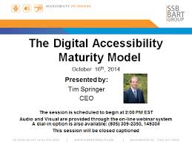
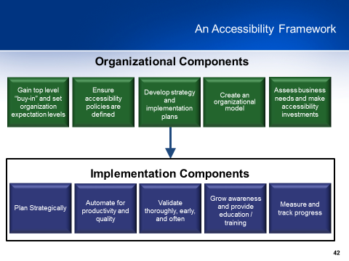
PDAA Reference Information
Techcheck – On Line Assessment Tool developed by the Partnership on Employment and Accessible Technology (PEAT) and sponsored by the Office of Disability Employment Policy (ODEP), U.S. Department of Labor
W3C – Web Accessibility Initiative - Planning and Implementing Web Accessibility
British standard BS-8878 Implementation Guide - by Hassell Inclusion - Accessibility business process integration
Strategic IT Accessibility: Enabling the Organization – Reference book on organizational accessibility enablement, strategy, and implementation
Digital Accessibility Maturity Model (DAMM) from SSB Bart Group - A Capability Maturity Model based framework to help digital accessibility programs measure their development against an objective yardstick
Accessibility Implementation Framework, Texas Department of Information Resources - A comprehensive framework and project plan to guide an organization’s IT accessibility program and initiatives

Slide 38
An Accessibility Framework
Organizational Components
Gain top level “buy-in” and set organization expectation levels
Ensure accessibility policies are defined
Develop strategy and implementation plans
Create an organizational model
Assess business needs and make accessibility investments
Implementation Components
Plan Strategically
Automate for productivity and quality
Validate thoroughly, early, and often
Grow awareness and provide education / training
Measure and track progress
38

Slide 39
IT Accessibility
Implementation Framework Template
Develop strategy and implementation plans
Plan Strategically | Obtain initiative support of organization executive team Develop long term organization goals Integrate into or develop processes to ensure consistency over time Select appropriate IT technologies / suppliers Effectively manage the IT accessibility exception process Maintain flexibility to adapt to criteria changes (508 refresh, WCAG 2.0, etc) Charter a workgroup with representation from key areas of the organization
Automate for productivity and quality | Provide developers tools to facilitate and remediate accessibility compliance Integrate accessibility into content management systems / processes Utilize standardized accessible templates (CSS, etc) Ensure browser neutral accessibility Utilize enterprise level scan tools for issue identification / resolution
Validate thoroughly, early, and often | Test internally developed pages and applications Test externally hosted services Test Published documents / information Perform analysis of vendor VPATs and test vendor solutions to validate Develop or integrate corrective actions process management / tools
Grow awareness and provide education / training | Evangelize accessibility throughout organization / IT supplier community Build / maintain organization’s technical capacity with SME’s Identify skill gaps, and resolve via and training staffing plans
Measure and track progress | Develop goal appropriate metrics, and reporting tools / methods Communicate and utilize results to drive initiative trajectory Maintain processes and results for “audit readiness” posture
Organization
Work Plan
39
Notes:
Plan Strategically
Obtain initiative support of organization executive team
Develop long term organization goals
Integrate into or develop processes to ensure consistency over time
Select appropriate IT technologies / suppliers
Effectively manage the IT accessibility exception process
Maintain flexibility to adapt to criteria changes (508 refresh, WCAG 2.0, etc)
Charter a workgroup with representation from key areas of the organization
Automate for productivity and quality
Provide developers tools to facilitate and remediate accessibility compliance
Integrate accessibility into content management systems / processes
Utilize standardized accessible templates (CSS, etc)
Ensure browser neutral accessibility
Utilize enterprise level scan tools for issue identification / resolution
Validate thoroughly, early, and often
Internally developed pages and applications
Externally hosted services
Published documents / information
VPAT analysis and testing of supplier solutions
Corrective actions process management / tools
Grow awareness and provide education / training
Evangelize accessibility throughout organization / IT supplier community
Build / maintain organization’s technical capacity with SME’s
Identify skill gaps, and resolve via and training staffing plans
Measure and track progress
Develop goal appropriate metrics, and reporting tools / methods
Communicate and utilize results to drive initiative trajectory
Maintain processes and results for “audit readiness” posture

Slide 40
Accessibility Implementation Framework:
2nd level
Plan Strategically
Automate for productivity and quality
Validate thoroughly, early, and often
Grow awareness and provide education / training
Measure and track progress
  Obtain initiative support of organization executive team
  Develop long term organization goals
  Integrate into or develop processes to ensure consistency over time
  Select appropriate IT technologies / suppliers
  Effectively manage the IT accessibility exception process
  Maintain flexibility to adapt to criteria changes (508 refresh, WCAG 2.0, etc)
  Charter a workgroup with representation from key areas of the organization
Notes:
A tool to plan, organize, and guide the journey
Plan Strategically
Automate for productivity and quality
Validate thoroughly, early, and often
Grow awareness and provide education / training
Measure and track progress
Elements of “Plan Strategically” Framework” component
Obtain initiative support of organization executive team
Develop long term organization goals
Integrate into or develop processes to ensure consistency over time
Select appropriate IT technologies / suppliers
Effectively manage the IT accessibility exception process
Maintain flexibility to adapt to criteria changes (508 refresh, WCAG 2.0, etc)
Charter a workgroup with representation from key areas of the organization

Slide 41
Accessibility Program Framework: 3rd level detail
Creation of action plans, project plans, work breakdown structures, etc.
Obtain initiative support of organization executive team
Develop long term organization goals
Integrate into or develop processes to ensure consistency over time
Select appropriate IT technologies / suppliers
Effectively manage the IT accessibility exception process
Maintain flexibility to adapt to criteria changes (508 refresh, WCAG 2.0, etc)
Charter a workgroup with representation from key areas of the organization
Organization
Work Plan
Framework Component | Work plan detailed line items | Priority | Status | Owner | Team | Start Date | Target Completion | Actual Completion | Dependencies
Integrate into or develop processes to ensure consistency over time | Review and modify as needed current process(s) for accessibility integration | H | Not Started | EIRAC | EIR dev | 10-Oct | 11-Jan |  | PM Contracts
Integrate into or develop processes to ensure consistency over time | Determine appropriate processes and process tools for EIR Accessibility | H | Green | EIRAC | Exec management / IRM | 15-Sep | 10-Oct |  | None
Integrate into or develop processes to ensure consistency over time | Analyze process(s) effectiveness. Are they being followed? | H | Green | EIRAC | Exec management / IRM | 10-Oct | 10-Jan |  | None
Integrate into or develop processes to ensure consistency over time | Integrate accessibility criteria and the exception process into development phases | M | Not Started | EIRAC | EIR dev | 10-Oct | 11-Jan |  | PM Contracts
Integrate into or develop processes to ensure consistency over time | Develop guidelines for integrating Accessibility development / test into project schedules | H | Not Started | EIRAC | EIR dev | 10-Oct | 11-Jan |  | PM Contracts
Integrate into or develop processes to ensure consistency over time | Develop work sizing guidelines for development and test planning | H | Not Started | EIRAC | EIR dev | 10-Oct | 11-Jan |  | PM Contracts
Notes:
Creation of action plans, project plans, work breakdown structures, etc.
Extends to action plan development and work breakdown structures
Plan strategically line item: Integrate into develop processes to ensure consistency over time
Work items associated with the line item that can be prioritized and planned
Review and modify as needed current process(s) for accessibility integration
Determine appropriate processes and process tools for IT Accessibility
Analyze process(s) effectiveness. Are they being followed?
Integrate accessibility criteria and the exception process into development phases
Develop guidelines for integrating Accessibility development / test into project schedules
Develop work sizing guidelines for development and test planning

Slide 42

Develop a Strategy
Develop strategy and implementation plans
Key elements of an organization’s IT accessibility strategy
Rationale and goals of the program
Linkage to the organization’s IT accessibility policy, relevant standards, regulations, etc.
Definitions of high-level organizational and governance models
Funding, budget, and other financial considerations
A strategic framework for developing operational work plans
Assumptions, dependencies, and risks

Slide 43
Prioritize the Work Effort
Develop strategy and implementation plans
Priority classification hierarchy example
Mission critical, high number of users, high revenue
Non-mission critical, high number of users, high revenue
Mission critical, low number of l users, low revenue
Non-mission critical, low number of users, low revenue
Mission critical, high number of users
Non-mission critical, high number of users
Mission critical, low number of users
Non-mission critical
low number
of users
External products, Internet and internet applications, etc.
Internal use: Intranet and intranet applications, desktop apps, copy machines, telecommunications, etc.
Notes:
Priority classification hierarchy* example
Externally facing, mission critical, high number of external users
Externally facing, non-mission critical, high number of external users
Externally facing, mission critical, low number of external users
Externally facing, non-mission critical, low number of external users
Internal use, mission critical, high number of users
Internal use, non-mission critical, high number of users
Internal use, mission critical, low number of users
Internal use, non-mission critical, low number of users

Slide 44
Form an Organizational Accessibility Workgroup
Plan Strategically
An interdepartmental team representing stakeholder areas of the organization that require or may be affected by IT accessibility
Facilitates progress in IT accessibility across the organization
Identifies inhibitors and works to resolve them as a team
Sponsors or leads IT Accessibility workgroup and subgroup efforts
Reports progress and issues to senior leadership
Solicits support of management and others as needed
Medical / occupational health
Other??
Application / web development
Project management
Intranet site owners
Learning
Internal EIR
Internet site owners
Legal / Civil Rights
HR
Procurement
Communications
Business controls / compliance office

Slide 45
Set Short and Long Term Accessibility Goals: Example
Measure and Track
Progress
Web Content: Public Facing and General Access Intranet | Web pages Maintain less than 2.5% pages with accessibility errors PDFs Reduction of inaccessible PDF Documents by 25% within 1 yr 10% additional reduction each subsequent year Non-PDF documents Reduction of inaccessible non-PDF Documents 50% within 1 yr 10% additional reduction each subsequent year
Validation | Select and procure accessibility web scanning tool for internet / intranet pages Begin monthly scans and remediation of errors
Internal / External Applications | New internally developed or purchased applications 75% to be accessible Existing applications 10% per year increase in compliance of existing applications
Training | Intro level accessibility training to staff 90% staff within 1 yr; remaining 10% in following year Accessible Office Documents training 50% staff trained within 1 yr; 50% balance in following year Web developer accessibility training 100% developers trained within 1 yr

Slide 46

Reporting Organization’s Accessibility Status
Measure and track progress
Keeps accessibility squarely on the radar of the executives
Shows organization progress being made (hopefully!)
Identifies problems / issues requiring more focus or executive support
Confirms that current focus areas match executive priority expectations
Motivates stakeholders to maintain momentum

Slide 47
Wrap-up / questions?

